Slide 1
Unit IV Direction Communication

Slide 3
Elements Direction and Communication

Slide 5
Principles of Directing
1. Maximum Individual Contribution
One of the main principles of directing is the contribution of individuals. Management
should adopt such directing policies that motivate the employees to contribute their
maximum potential for the attainment of organizational goals.
2. Harmony of Objectives
Sometimes there is a conflict between the organizational objectives and individual
objectives. For example, the organization wants profits to increase and to retain its
major share, whereas, the employees may perceive that they should get a major share as a bonus as they
have worked really hard for it.
Here, directing has an important role to play in establishing harmony and coordination between the
objectives of both the parties.
3. Unity of Command
This principle states that a subordinate should receive instructions from only one superior at a time. If he
receives instructions from more than one superiors at the same time, it will create confusion, conflict, and
disorder in the organization and also he will not be able to prioritize his work.
4. Appropriate Direction Technique
Among the principles of directing, this one states that appropriate direction techniques should be used to
supervise, lead, communicate and motivate the employees based on their needs, capabilities, attitudes and
other situational variables.

Slide 6
5. Managerial Communication
According to this principle, it should be seen that the instructions are clearly conveyed
to the employees and it should be ensured that they have understood the same meaning
as was intended to be communicated.
6. Use of Informal Organization
Within every formal organization, there exists an informal group or organization. The
manager should identify those groups and use them to communicate information. There
should be a free flow of information among the seniors and the subordinates as an
effective exchange of information are really important for the growth of an
organization.
7. Leadership
Managers should possess a good leadership quality to influence the subordinates and
make them work according to their wish. It is one of the important principles of
directing.
8. Follow Through
As per this principle, managers are required to monitor the extent to which the policies,
procedures, and instructions are followed by the subordinates. If there is any problem in
implementation, then the suitable modifications can be made.

Slide 7
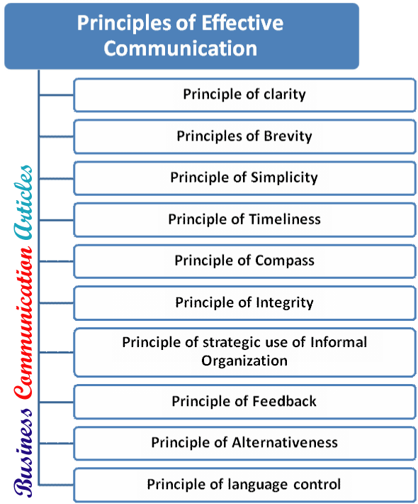

Slide 8
Techniques Direction

Slide 12
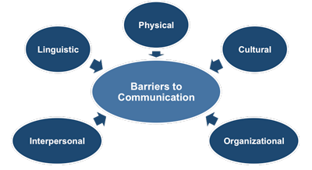

Slide 14
Thanking You

