Slide 1
Unit II
Human Resource Planning

Slide 4
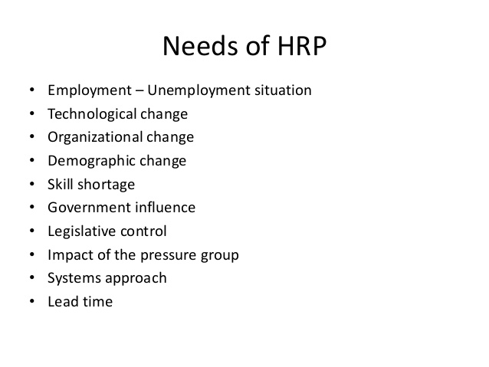

Slide 5
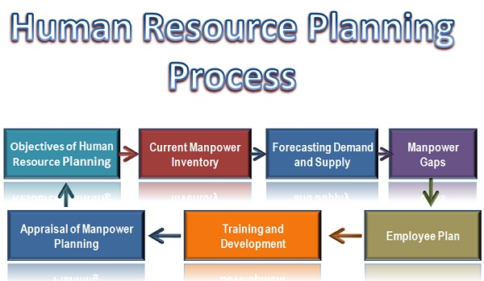

Slide 10
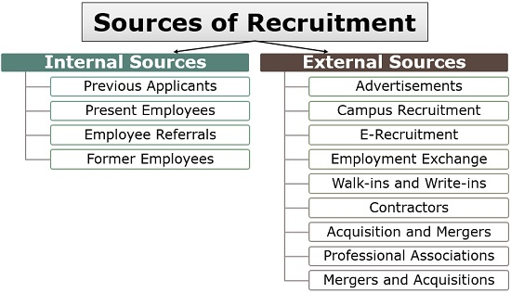

Slide 12
Element of HIRS

Slide 13
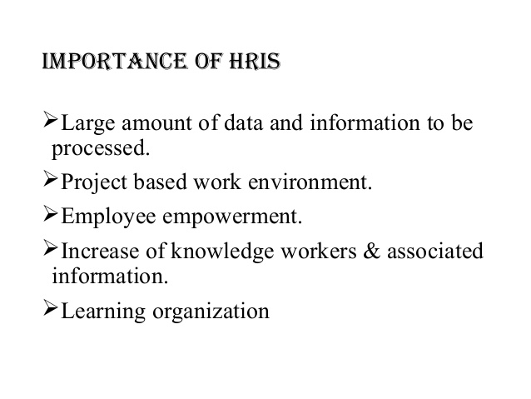

Slide 15
Thanking You

